Slide 1
Targeted Media’s Effects on
Misogynistic Behavior in Younger Generations
By Alonzo Bradford, Grace Calfee, Jared Dy, Aadi Shah

Slide 2
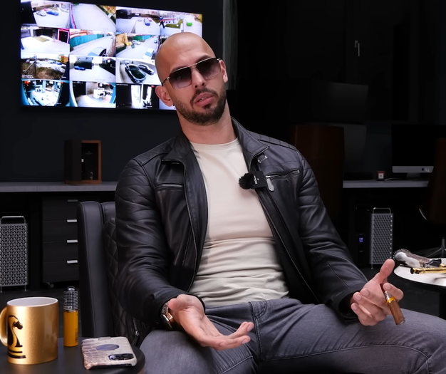
Background
This year in Adelaide, Australia
two high schools have sent out
letters to parents about Andrew Tate.
(Vincent)
(Andrew Tate)
Source: Daily Mail Australia

Slide 3
Targeted Media
Collecting Large Amounts of Data
Behavior Analysis
Exposure to Targeted Posts

Slide 4
Issues with Targeted Media
“The average young person views more than 3000 ads per day on television (TV), on the Internet, on billboards, and in magazines.”
-American Academy of Pediatrics
Overexposure to Same Advertising Tactics

Slide 5
“What can be implemented in order to limit the influence of targeted advertising on the way younger generations perceive misogyny?”

Slide 6
Solutions
Industry Initiatives
Community Resources
Legislative Constraints

Slide 7
Industry Initiatives
Regulations to control advertisements for children.

Slide 8
Governmental Control
Violations
-Violates 1st Amendment
-Creates Bias
Public List
-Advertisements Allowed + Not Allowed for children

Slide 9
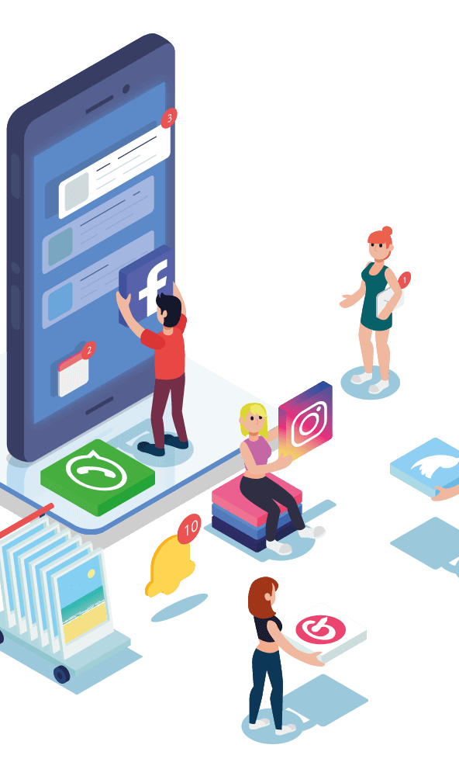
Regulation on Companies
A complex idea can be conveyed with just a single still image, namely making it possible to absorb large amounts of data quickly.
Notes:
Img source https://www.google.com/url?sa=i&url=https%3A%2F%2Fm16marketing.com%2Fatlanta-social-media-company%2F&psig=AOvVaw03eako1esYU5akAmMzyfYx&ust=1666144940564000&source=images&cd=vfe&ved=0CAoQjhxqFwoTCMDQ_d_X6PoCFQAAAAAdAAAAABAD

Slide 10

Regulation Flaws
Very difficult to appease both sides
Offers government more control
Notes:
Img source
https://www.google.com/url?sa=i&url=https%3A%2F%2Fblog.hootsuite.com%2Fsocial-media-advertising-stats%2F&psig=AOvVaw3k1-AxJJrIPp8I8ZptVRka&ust=1666145100036000&source=images&cd=vfe&ved=0CAoQjhxqFwoTCJjfzavY6PoCFQAAAAAdAAAAABAD

Slide 11
Community Resources
Releasing PSAs and resources to educate parents on Targeted Media.

Slide 12
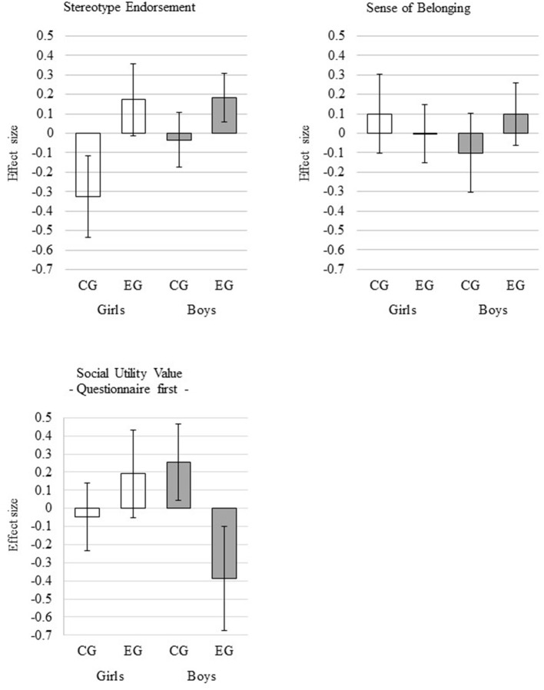
-Children are very impressionable
-Their mental health can be directly affected by the advertisements they see
-If shown unsafe images and or ideals they have a higher chance of believing and or enacting them
Correlation between Gender Roles and Stereotypes
Notes:
https://www.ncbi.nlm.nih.gov/pmc/articles/PMC6288401/

Slide 13
Educational Flaws
Violations
-Violates 1st Amendment
-Creates Bias
Public List
-Advertisements Allowed + Not Allowed for children

Slide 14
Community resources
PSAs
Education surrounding Targeted Media
Classes

Slide 15

Flaws Regarding Education
-Difficulty in large groups
-Success relies on Parents/Community
-Resource Funding

Slide 16
Legislative Constraints
Releasing PSAs and resources to educate parents on Targeted Media.

Slide 17

Advertising Guidelines
Controlling Content
Stricter Guideline
Legislative Compromise
-Restricts risky content in Ads
-Harsher punishment for harmful Advertisements
-Allows both sides to benefit from legislatures new laws
Notes:
https://www.google.com/url?sa=i&url=https%3A%2F%2Fcalcurates.com%2Fhow-to-start-a-dropshipping-business&psig=AOvVaw2oIpJtgQ_DyQng3ks5rZgg&ust=1666156620857000&source=images&cd=vfe&ved=0CAoQjhxqFwoTCIi8qqCD6foCFQAAAAAdAAAAABAN

Slide 18

Previous Solutions
COPPA
- Requirements on collecting Personal Information from children under 13
BSAA
- Prevents advertisers to use data for targeted advertising
FTC
- Committee dedicated to protecting children from stealth advertisements
Notes:
https://www.google.com/url?sa=i&url=https%3A%2F%2Fwww.kissclipart.com%2Ffamily-protection-icon-clipart-child-protection-fa-6zj7j5%2F&psig=AOvVaw14nWz8dpbEh4abj_WixWmZ&ust=1666156440801000&source=images&cd=vfe&ved=0CAoQjhxqFwoTCID-j8qC6foCFQAAAAAdAAAAABAD

Slide 19

Constraints Details

Slide 20
Limitations
Violating company’s speech, and fights for control.

Slide 21
Additional Issues
Younger Generations
Need for Larger Laws + Regulations
Reliance on Consumers

Slide 22
Companies need to be held accountable for their actions.

Slide 23
Works Cited
Ging, Debbie, and Shane Murphy. “TRACKING THE PILLING PIPELINE: LIMITATIONS, CHALLENGES AND A CALL FOR NEW METHODOLOGICAL FRAMEWORKS IN INCEL AND MANOSPHERE RESEARCH.” View of Tracking the Pilling Pipeline: Limitations, Challenges and a Call for New Methodological Frameworks in Incel and Manosphere Research, Association of Internet Researchers, https://journals.uic.edu/ojs/index.php/spir/article/view/12174/10301.
Williams, Zoe. “Yes, Andrew Tate Is a Loathsome Human Being. but My 14-Year-Old Isn't Taken in by This 'King of Toxic Masculinity' | Zoe Williams.” The Guardian, Guardian News and Media, 29 Aug. 2022, https://www.theguardian.com/commentisfree/2022/aug/29/andrew-tate-loathsome-toxic-masculinity-teenage-boys.
Wille, Eike, et al. “Gender Stereotypes in a Children's Television Program: Effects on Girls' and Boys' Stereotype Endorsement, Math Performance, Motivational Dispositions, and Attitudes.” Frontiers in Psychology, Frontiers Media S.A., 4 Dec. 2018, www.ncbi.nlm.nih.gov/pmc/articles/PMC6288401/.
https://www.insider.com/andrew-tate-tiktok-hustlers-university-misogyny-women-comments-mens-rights-2022-8

Slide 24
Works Cited
Schiff Friday, Allison, and Anthony R January 22. “Even If Targeted Online Advertising Isn't Banned – Take Note Of Which Way The Wind Is Blowing.” AdExchanger, 21 Jan. 2022, www.adexchanger.com/privacy/even-if-targeted-online-advertising-isnt-banned-take-note-of-which-way-the-wind-is-blowing/.
Thorsberg, Christian. “Andrew Tate Isn't Just Another Misogynist with an Online Following. Here's Why You Need to Pay Attention.” Grid News, Grid News, 30 Aug. 2022, www.grid.news/story/technology/2022/08/23/andrew-tate-isnt-just-another-misogynist-with-an-online-following-heres-why-you-need-to-pay-attention/.
World Health Organization. “Protecting Children From Harmful Marketing Practices” WHO, May 2020, https://cdn.who.int/media/docs/default-source/a-future-for-children/policy-brief-3---commercial-marketing.pdf?sfvrsn=98d4a30b_2&download=true

Slide 25
Images Cited
“Atlanta Social Media Company.” M16 Marketing, 10 Oct. 2022, m16marketing.com/atlanta-social-media-company/.
Beveridge, Claire. “56 Important Social Media Advertising Stats for 2022.” Social Media Marketing & Management Dashboard, 9 June 2022, blog.hootsuite.com/social-media-advertising-stats/.
Kieran Press-Reynolds, Michele Theil. “'One-Stop Hate Shop': Andrew Tate's Rise to TikTok Superstardom Is Fueling Violent Misogyny and Men's Rights Extremism.” Insider, Axel Springer SE., 18 Aug. 2022, www.insider.com/andrew-tate-tiktok-hustlers-university-misogyny-women-comments-mens-rights-2022-8.
Kratovich, Polina. “How to Start a Dropshipping Business: A Complete Playbook.” How to Start Dropshipping : A Complete Playbook, Apr. 2021, calcurates.com/how-to-start-a-dropshipping-business.

